Slide 1
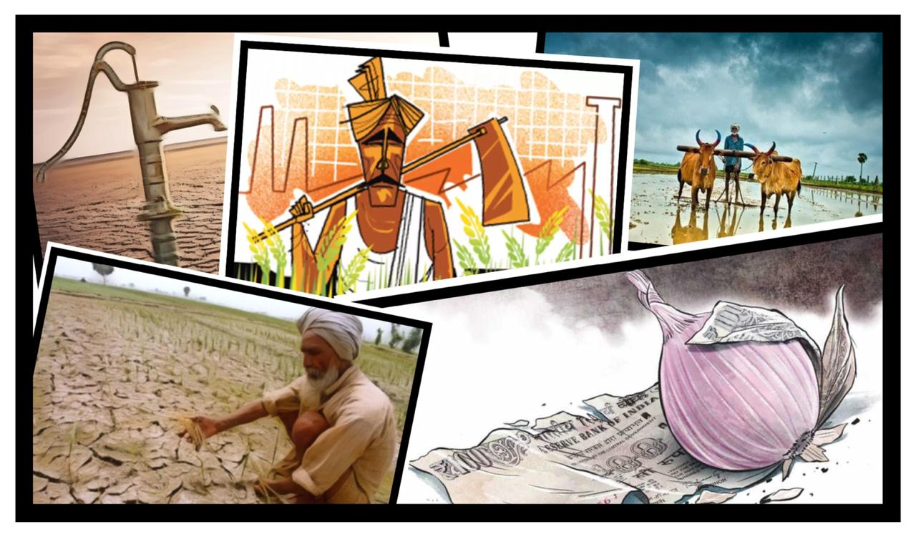

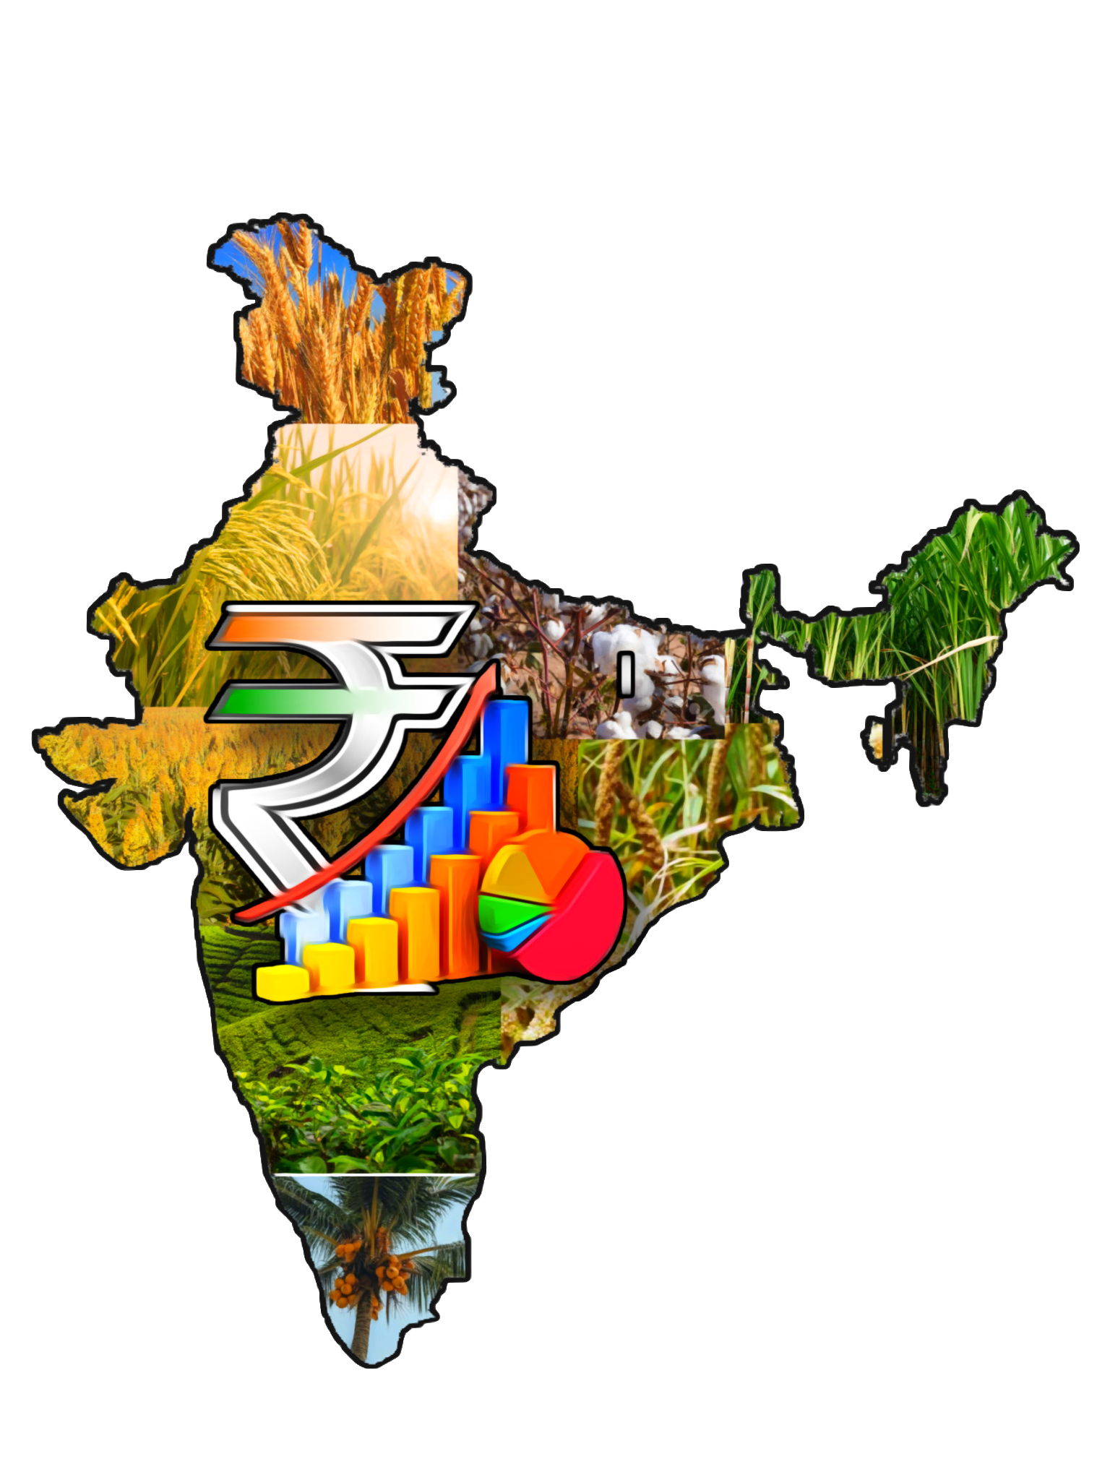
Unified System for Agricultural Prediction using AI
College: K. J. Somaiya Institute of Engineering and Information Technology, Sion, Mumbai

Slide 2
Problem We Are Solving
Issue: Trend of increase in price of agricultural products due to -
Failure of monsoon or late arrival of monsoon and decline in sown area of that year
Lack of unified Prediction and Forecasting System
Lack of analysis on integrated data such as Meteorological data of forecast, yield/production data across states, Inventory and Public distribution, Wholesale and Retail agricultural commodity process etc.
Solution: Predictive Analytics based on AI, ML, Deep Learning from the huge volume of data from above sources
Desired Outcome: Unified Predictive Analysis for -
Taking timely action for distribution planning and price control
Providing integrated data as input for Budget planning & monetary allocation to Agriculture at federal and state level
Beneficiaries: Various Agricultural Departments such as Food and Public distribution under the Ministry of Agriculture, Prime Minister’s PMO, etc.

Slide 3
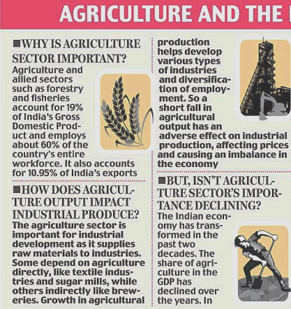
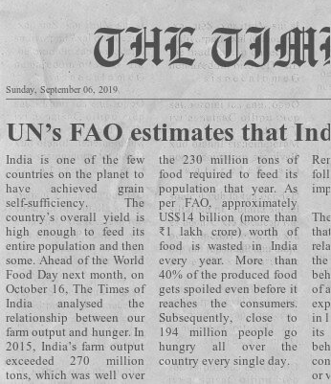
UN’s FAO estimates that India wastes around 1/3rd yield owing to improper storage
58% of India’s population relies on Agriculture as a source of livelihood

Slide 4


USAPA
Why?
What?
Improper storage and warehouse management
Inefficient farming and irrigation practices
Uncertain weather conditions
Unifying multiple data sources
Streamlining warehousing, storage, demand and supply
Providing ways to deal with weather uncertainties
Who?
How?
Policy Makers, for Central and State governments.
Ministry of Agriculture and Farmers Welfare
Unified platform for aiding planning and decision making
AI assisted agricultural predictions for planning
Comparative study of parameters

Slide 5
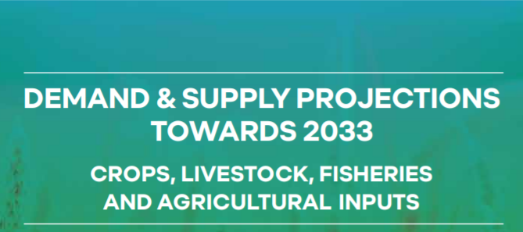
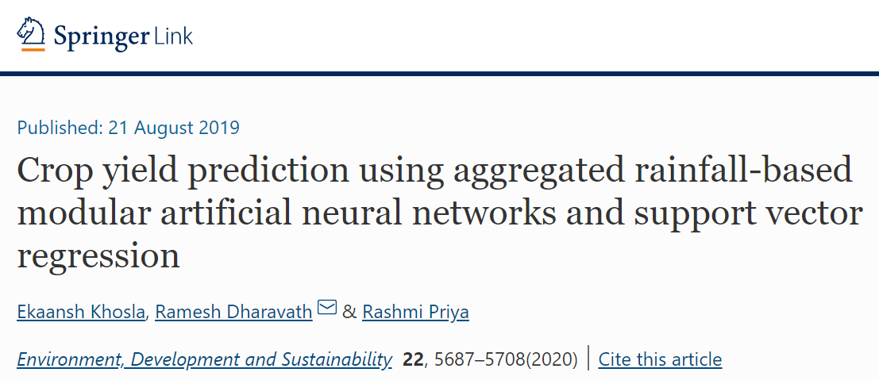

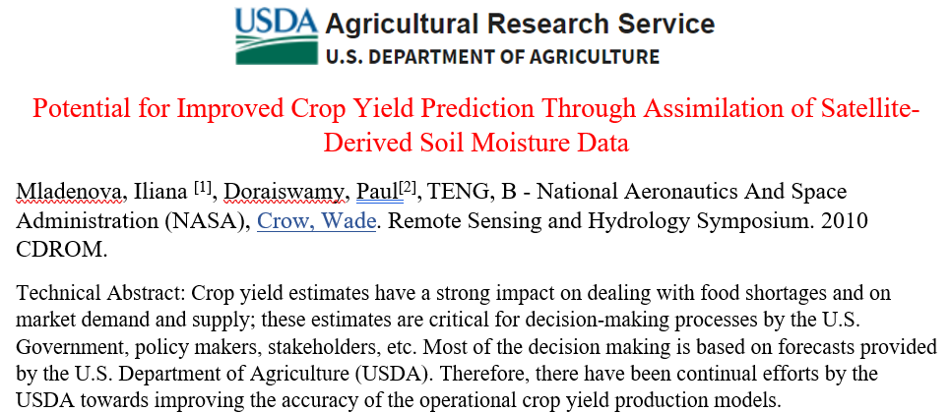
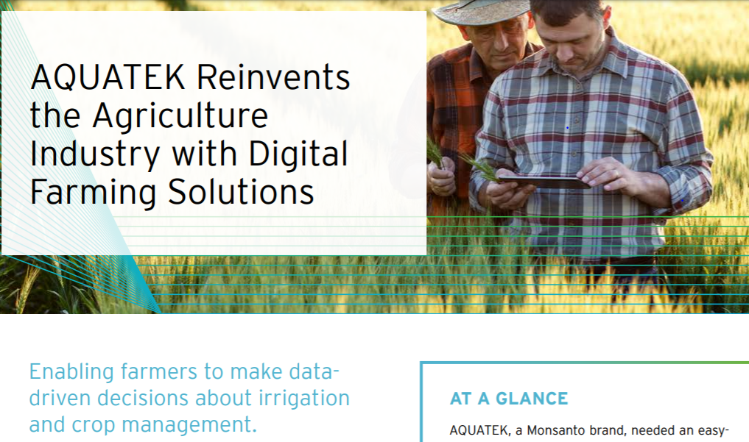

“Modern Agriculture relies completely on the development of computer-based systems and artificial intelligence”
- Non-Linear Regression for Remote Sensing Applications for yield prediction
Published in: IEEE Transactions on Geoscience and Remote Sensing
Volume: 21 , Issue: 5 , Oct 2009

Slide 6
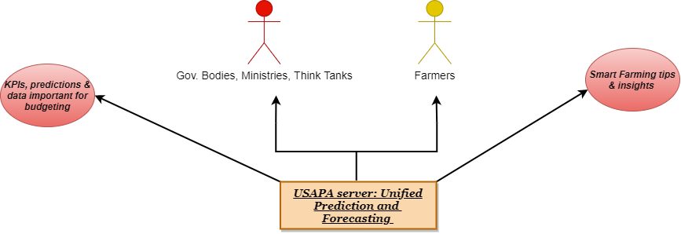
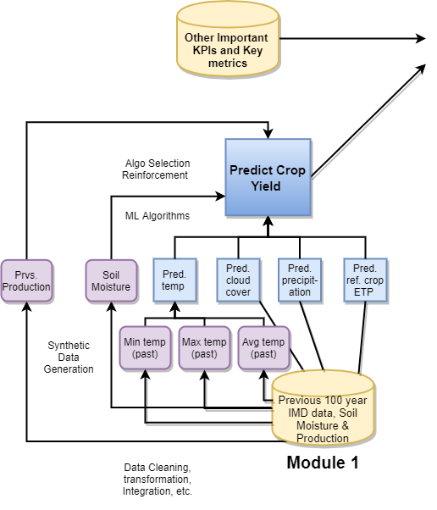
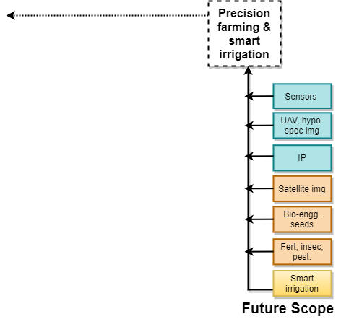
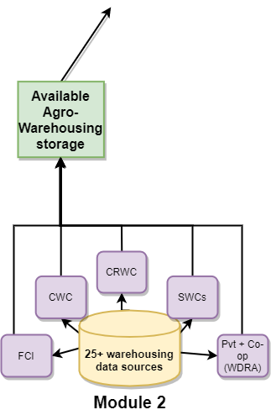
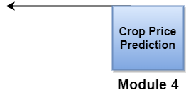
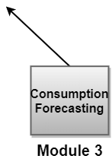
System Architecture

Slide 7



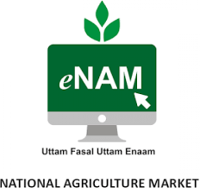







Significant Data Sources
Weather & Production Data
Pricing Data
Ministry of Agriculture & Farmers Welfare,
Government of India
Warehousing Data
Consumption Data
Food Corporation of India
Central Railside Warehouse Company

Slide 8














Technology Stack
Data Gathering and Preprocessing
Database, Storage and Scalability
Frontend Tools
Data Gathering & Preprocessing
Artificial Intelligence
API Development
Other Tools

Slide 9

Predictive Analysis
DISTRICTS CONSIDERED
CROPS CONSIDERED
1. 100 Years Weather data
Temperature (Min, Max, Avg)
Cloud Cover
Precipitation
Reference Crop Evapotranspiration
2. Soil Moisture Data
Two years of soil moisture data in pasm %, extrapolated to 10 years using synthetic data generation
3. Historical Crop Production Data
District-wise season-wise historical production data since 1997, with following parameters:
Production
Yield
Cultivation Area
343
55
MODELS TRAINED
10,000+
ALGORITHMS TESTED
MAN-HOURS FOR MODELLING
13
520+
[1] Indian Meteorological Dept, FAO Seminar, JETIR paper
[2] NCFC (Satellite Data), Springer Nature Article, USDA Research paper
[3] Ministry of Agriculture and Farmers Welfare; Department of Agriculture, Cooperation and Farmers Welfare

Slide 10
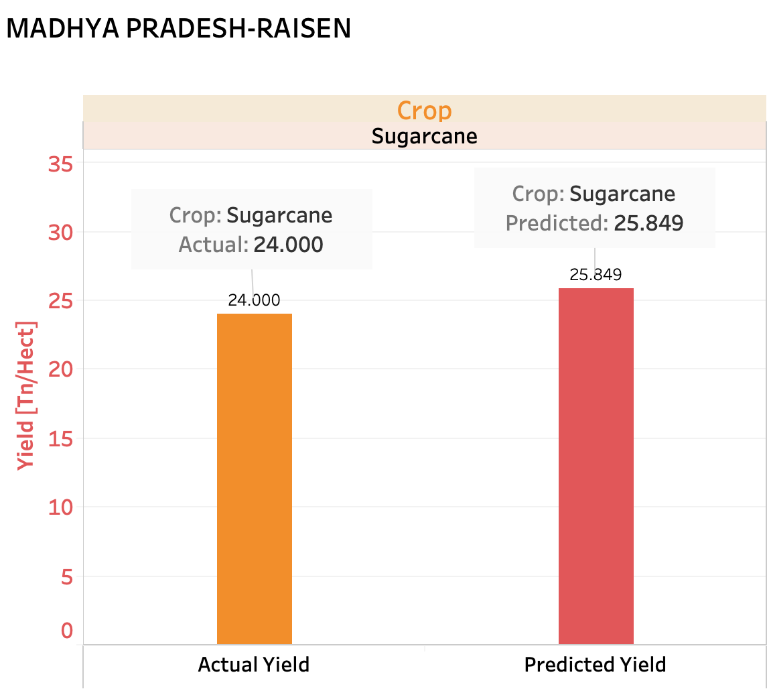
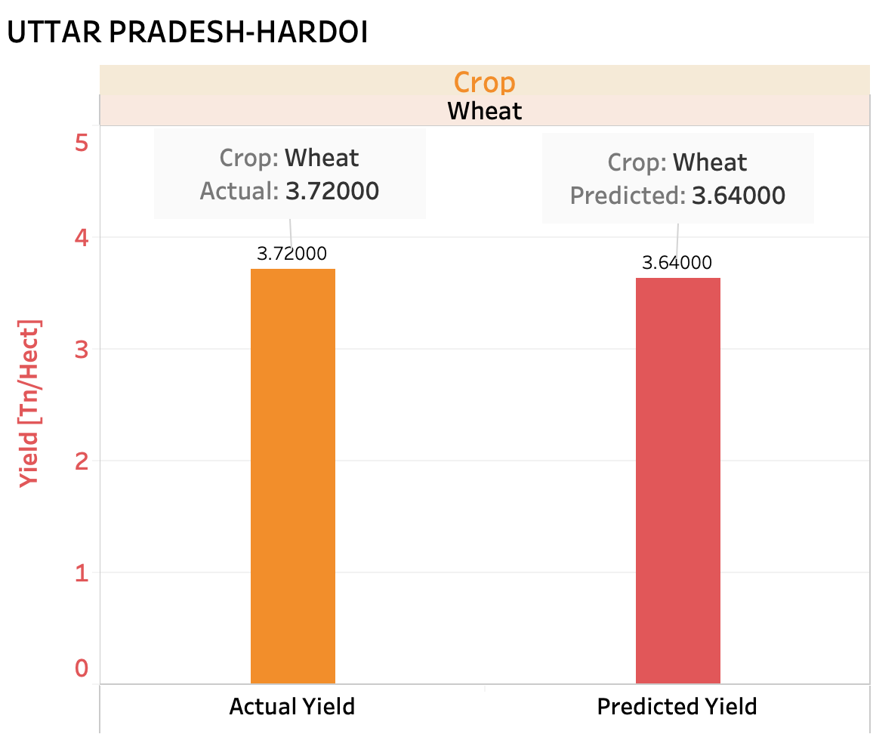
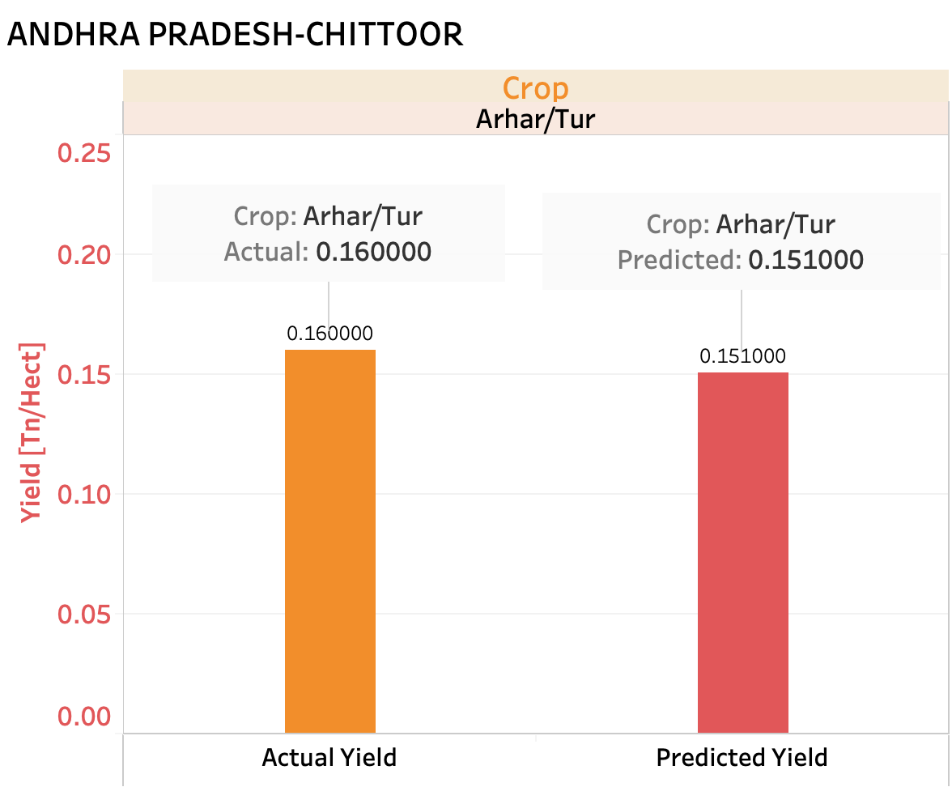
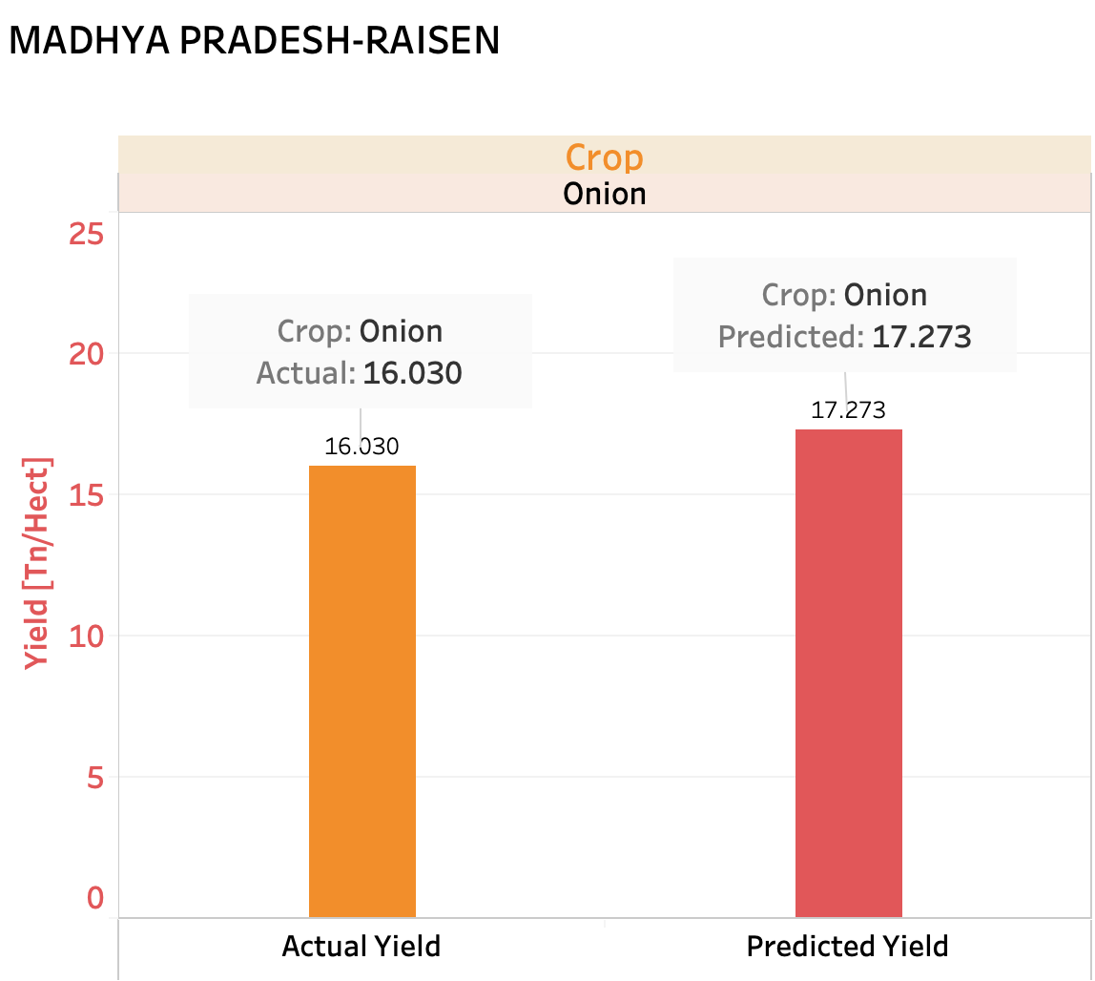
AI Algorithms & Implementation
Algorithms | RMSE %
AdaBoostRegressor | 3.0949
GradientBoostingRegressor | 6.1932
ExtraTreesRegressor | 4.0733
RandomForestRegressor | 4.7826
BaggingRegressor | 5.1440
SupportVectorRegressor | 1.4371
Other algorithms used:
HuberRegressor
KNeighboursRegressor
Artificial Neural Networks

Slide 11
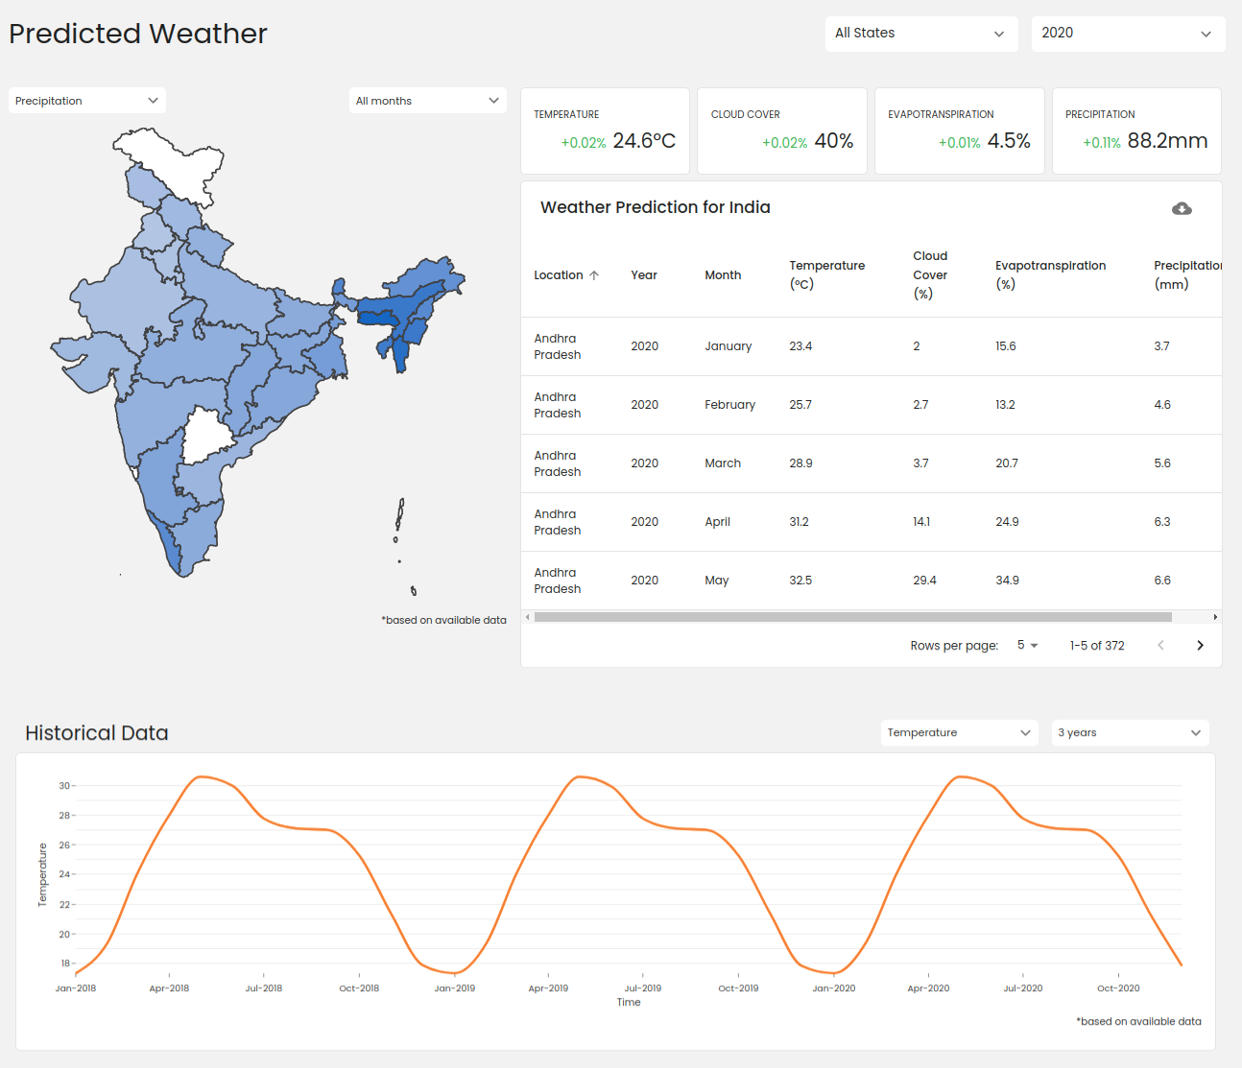
Feature Showcase
Weather Forecast and Visualization of Historical Weather Data
Showcase Soil Health, NDVI, NDWI, and other weather Indices
Future Crop Yield and Production Prediction
Compare Predictions and
Historic Data
Consumption and Crop price prediction
Add New Crop for Analysis and Prediction

Slide 12
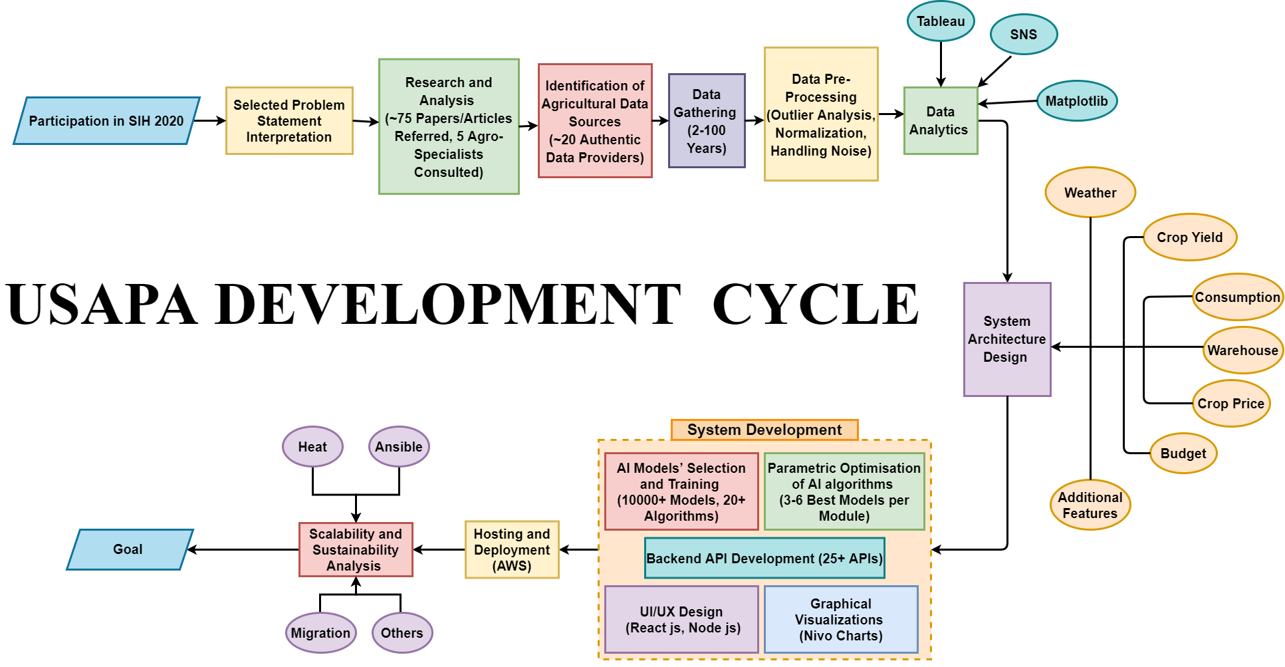

SUMMARY

Slide 13
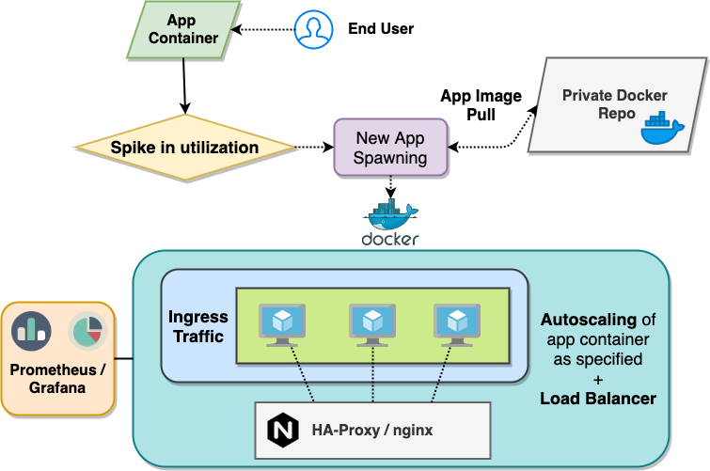
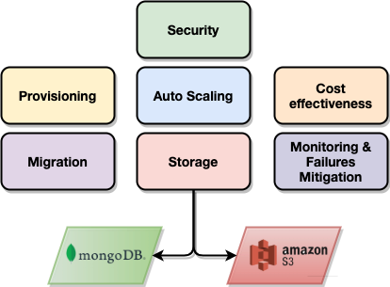
STORAGE AND SCALABILITY

Slide 14
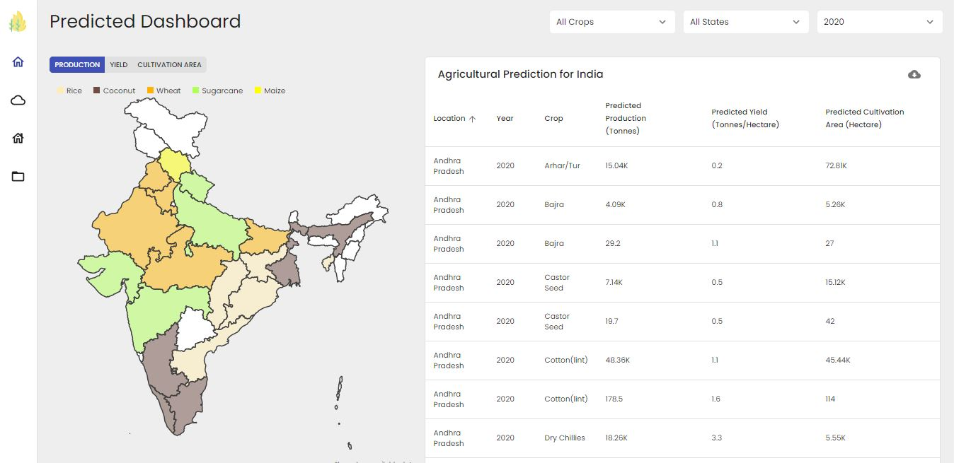
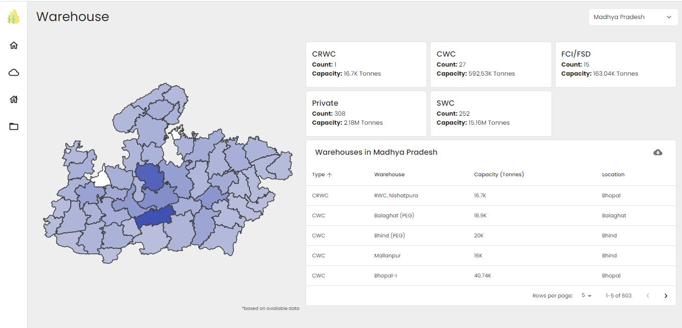
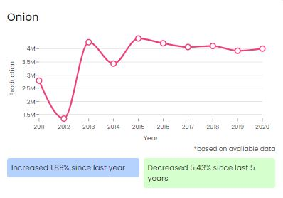
UNIQUE SELLING PROPOSITION
Unified Platform for Major Agro Predictions and Historical Data Visualizations
Models Built on Authentic & Real Data
Rigorously Tested - Accurate AI Predictions
Incremental Learning
Scalable and Sustainable System
Assists in Budget Planning, Policy Framing, Guiding Agro Industries & Farmers
User-Friendly Interface,
Lightweight and Fast

Slide 15
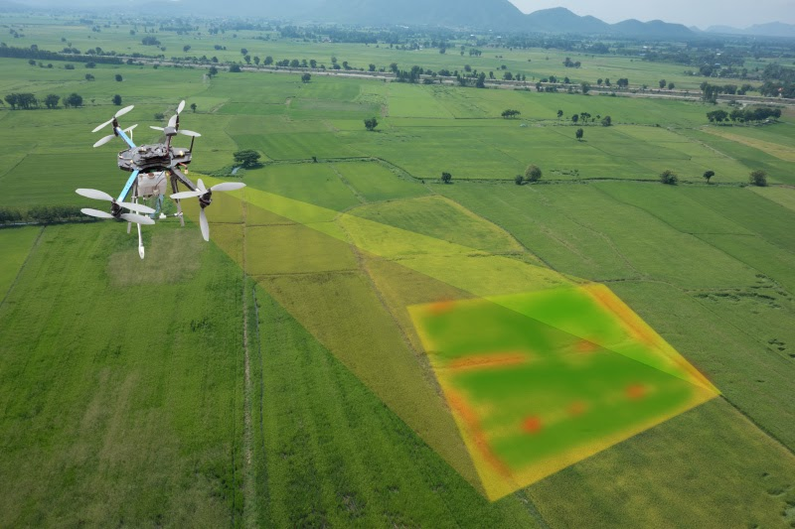
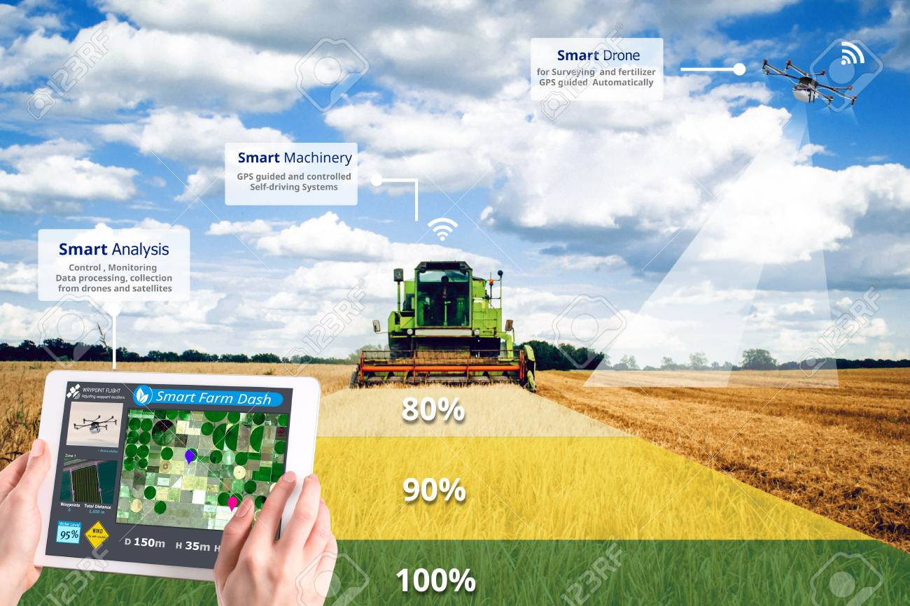
Future Scope & Open Issues
Consideration of External Factors such as Natural Calamities, Economical Changes
Collaboration with Agro Industries for USAPA Customization
Inclusion of Precision Farming and Smart Irrigation related Predictions
Provide Yield-based on Dynamic Parameters like Land Input by User, Water Availability, etc.

Slide 16
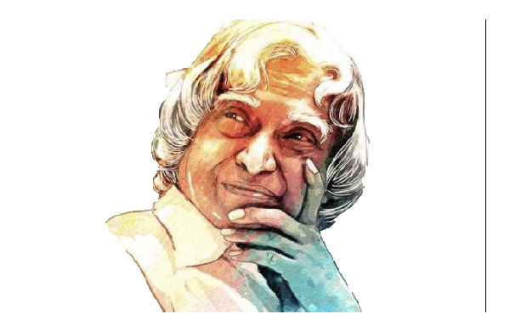
“Innovate to Empower Agriculture.
Innovation is the only key for non-linear growth”
Dr. APJ Abdul Kalam
Thank You!

